Slide 1
Feature Engineering
Sandip Pani
Senior Staff Engineer (Sr. Data Architect)

Slide 2
Sandip Pani
I work for NextGen HealthCare ( Sr. Data Architect)
DataPlatformGeeks Regional Mentor & UG Lead
12+ years of experience on Data
AI/ML Enthusiast
  Speaker at global conferences (SQLBits – 2013, Notingham, UK and 2015, London), SSGAS 2016, DPS 2017 , DPS 2018, Meet-Ups and Local User Groups
  MCTS, MCITP: Admin, BI & Developer certification
Specialized in Query Tuning and Performance Optimization
Passionate about Data
Blogger (http://www.sqlservergeeks.com/author/sandippani/)

Slide 3
Agenda
Introduction to Feature Engineering
Feature Types
Problems with feature
Feature Engineering Techniques
Demo

Slide 4
What is feature engineering?
The problem of transforming raw data into a dataset is called feature engineering
Transferring data to create model input is called feature engineering
Raw data-> data cleaning ->feature engineering ->model building
In most model data science application we start with lots of data, and care more on prediction than explanation
Too much feature engineering can lead to overfitting

Slide 5
Importance of Feature Engineering
Features directly influence the predictive models we use and the results we can achieve.
Flexibility: good features will allow you to use less complex models that are faster to run, easier to understand and easier to maintain. This is very desirable.
Simpler models: You do not need to work as hard to pick the right models and the most optimized parameters.
Better features -> better result

Slide 6
What people says about FE
Actually the success of all Machine Learning algorithms depends on how you present the data. By Mohammad Pezeshki
The algorithms we used are very standard for Kagglers. […] We spent most of our efforts in feature engineering. Xavier Conort, on winning the Flight Quest challenge on Kaggle
You have to turn your inputs into things the algorithm can understand by Shayne Miel

Slide 7
Key things to know about ML
Feature: Numeric representation of raw data
Model : Mathematiocal summary of features
Chose the right model and features given data and task

Slide 8
Data Types
Numerical
Datetime
Categorical(labels)
Discrete
Continuous
Nominal
Ordinal
There’s a fixed number of integer
Values.
Ex. Number of house you have.
Number of family members etc.
It can take an infinite number of
Values.
Ex. House price, Temperature etc.
You can brand it and order is not important. Mean median are meaning less
Ex. Nationality, Gender, Color Type
If you can order it or rank it. Ordinal data are discrete integers that can be ranked or sorted.
Ex. Designation, Class
Recommended reading :http://bit.ly/datatypesML

Slide 9
Problem with features
Missing Data (MCAR, MAR, MNAR)
Labels Cardinality: Variables with too many labels tend to dominate over those with only a few labels, particularly in Tree based algorithms
Labels Infrequent categories: present in training set but not in test set or present in test set not in train set
Outliers Unusual or unexpected values: Affect some algorithms and some algorithms are not impacted

Slide 10
Missing Data Mechanisms
Missing Completely at Random( MCAR):
The probability of missing data on any attribute does not depend on any value of attribute. Missing data points are a random subset of the data. There is nothing systematic going on that makes some data more likely to be missing than other.
Missing at random (MAR) :
The probability an observation being missing depends only on available information (other variables in the dataset).
Missing Not at Random, (MNAR):
Missing of values is not at random (MNAR) if their being missing depends on information not recorded in the dataset. In other words, there is a mechanism or a reason why missing values are introduced in the dataset.

Slide 11
Numeric Feature Engineering
There are a lot of different types of numerical data, example:
counts
price
percentages
Measurements
Age
Numeric Features are about:
Scale: the range of values
Distribution: the probability of taking on a particular value

Slide 12
Dealing with count
Binarization
The core of quantitative feature binarization is to set a threshold. The value greater than the threshold is 1 and the value less than or equal to the threshold is 0.
Ex. If you are only care about a student is passed or not , you need to convert the quantitative test score into “1” and “0”.
Quantization or Binning
You have a numerical feature but you want to convert it into a categorical one. Binning (also called bucketing) is
the process of converting a continuous feature into multiple binary features called bins or buckets, typically based on value range. Binning helps solve the skewness problem.
Types : Fixed width binning, quantile binning
Ex- Age grouping

Slide 13
Feature Scaling
Two common scaling techniques
Normalization
Standardization
Some algorithms may not perform efficiently when the numerical features have different scales (e.g. KNN, KMeans Clustering, PCA...)
Scaling helps provide better mathematical properties in some algorithms
Feature scaling always divides the feature by a constant. And it does not change the distribution of your data

Slide 14
Standard Scaling (Standardization)
Features are scaled with a mean of 0 and std of 1
Useful when comparing measurements with different units
Useful when your model is sensitive to magnitude
EX:PCA : We’re interested in the components that maximize the variance
X - mean/ sd

Slide 15
Normalization (Min/Max Scaling)
Features are scaled from 0-1 or any other fixed range
Ends up with smaller standard deviations
Example: Image Processing
When you want to normalize the pixel intensity to 0-255 (RGB
color range)
Formula : (X – min(X))/ (max(X) – min(X))

Slide 16
Encoding Categorical Variables
Encoding Categorical Variables
Two Common Approaches:
1. Label Encoding - Each category are labeled as ordered integers
2. One Hot Encoding / Dummy Encoding - Transform
categories into individual binary feature (0 or 1) features lying in different ranges.

Slide 17
Demo on Feature Engineering

Slide 18
Summary
what is FE and importance of FE
Data Types
Missing data problem
Numeric Feature Engineering
Feature scaling and categorical encoding
Q & A ?

Slide 19
Help Us Grow The Community
www.facebook.com/groups/theSQLGeeks
We are posting today’s group pic in our FB Group.
Share it on your wall and post comments. Let your friends know that you joined today’s session and it was worth your time. Invite them to www.DataPlatformGeeks.com so that they too can benefit. We all grow together.

Slide 20
DataPlatformGeeks (DPG) Community
Join the fastest growing community of data & analytics professionals
Why Join DPG?
Attend all events hosted by DPG, including SQLMaestros Special Events
Get access to free videos, labs, magazines and host of learning resources
Download all events & conference material
Learn new skills. Sharpen existing skills
Be part of Asia’s Largest Data/Analytics Community
Opportunity to be a regional mentor & speaker at our events
Immense technical & professional development
www.DataPlatformGeeks.com
www.SQLServerGeeks.com

Slide 21
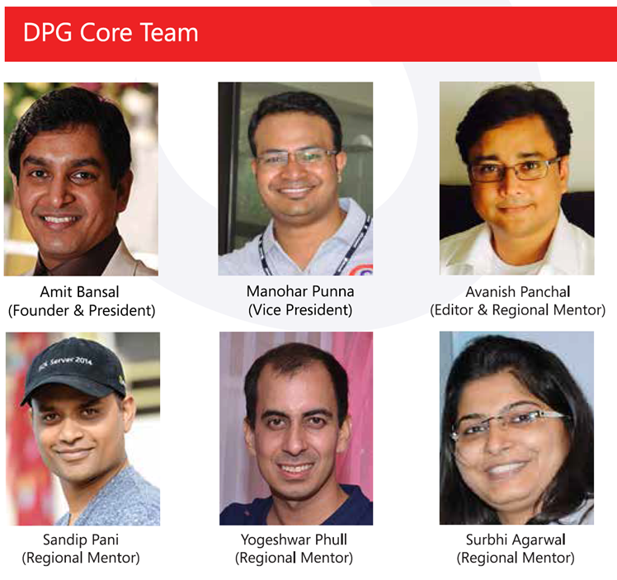
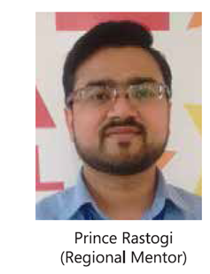

Slide 22
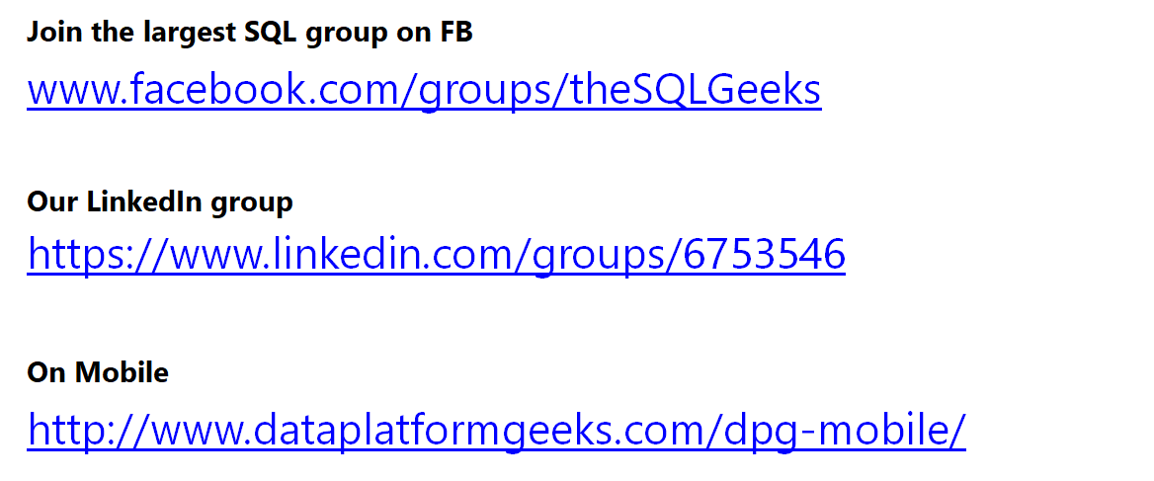
Have Questions?

Slide 23

@SQLServerGeeks
www.YouTube.com/SQLServerGeeks
www.DataPlatformGeeks.com
www.SQLServerGeeks.com
@SQLServerGeeks | admin@DataPlatformGeeks.com
facebook.com/SQLServerGeeks
facebook.com/groups/theSQLGeeks
Join The Community on Mobile
http://www.dataplatformgeeks.com/dpg-mobile/

